Slide 1
Airbnb Property Performance
By Aswin Sadanandan

Slide 2
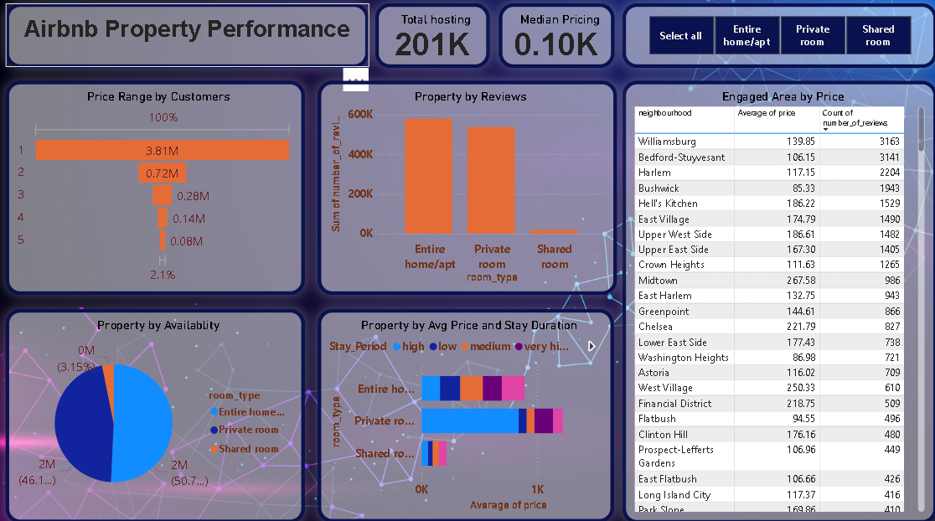
Introduction
As travel demand recovers post-pandemic, Airbnb aims to strategize to maximize revenue growth. This presentation outlines insights on host acquisition, customer segmentation, property enhancement, and market positioning to support business expansion and competitive advantage.

Slide 3
01
Host Acquisition Strategy

Slide 4
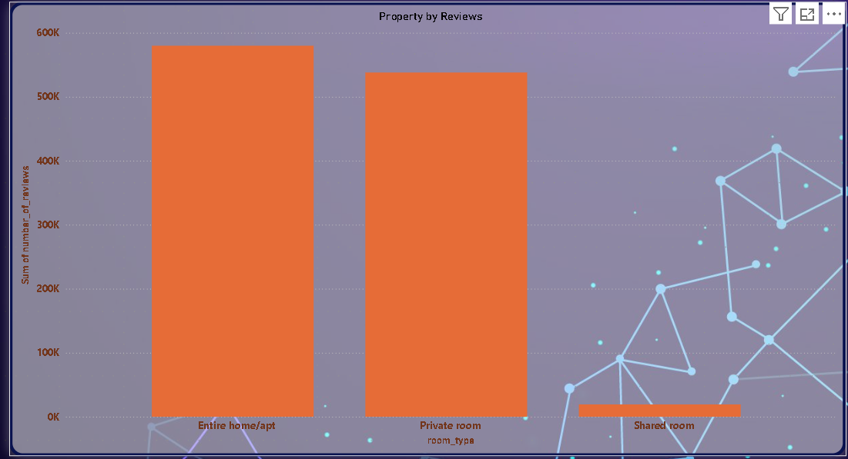
Identifying high-value host profiles
Focusing on hosts with high booking rates and positive reviews is crucial. Targeting experienced hosts who offer unique or high-demand properties can increase customer satisfaction and revenue. Understanding host performance metrics allows Airbnb to prioritize acquisition effectively.

Slide 5
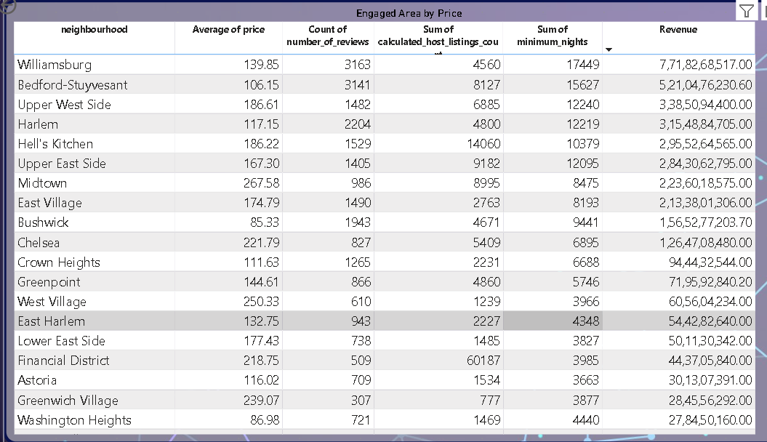
Geographic focus for host acquisition
Identifying key markets with rising travel demand is essential. Cities or neighborhoods showing growth trends should be prioritized for recruiting new hosts. This ensures Airbnb’s supply aligns with customer needs geographically and supports localized business growth.

Slide 6

Optimizing host onboarding process
Streamlining onboarding to support hosts quickly and effectively improves host retention and quality. Providing tools, training, and clear guidelines will help new hosts meet Airbnb standards, enhancing the overall customer experience.

Slide 7
02
Customer Segmentation and Preferences

Slide 8

Target neighborhoods based on customer data
Data analysis identifies neighborhoods with the highest booking demand and growth potential. Prioritizing marketing and host acquisition in these areas enables Airbnb to meet customer preferences effectively. Targeting based on demographic and behavioral data helps in crafting localized strategies to increase bookings and customer satisfaction.

Slide 9
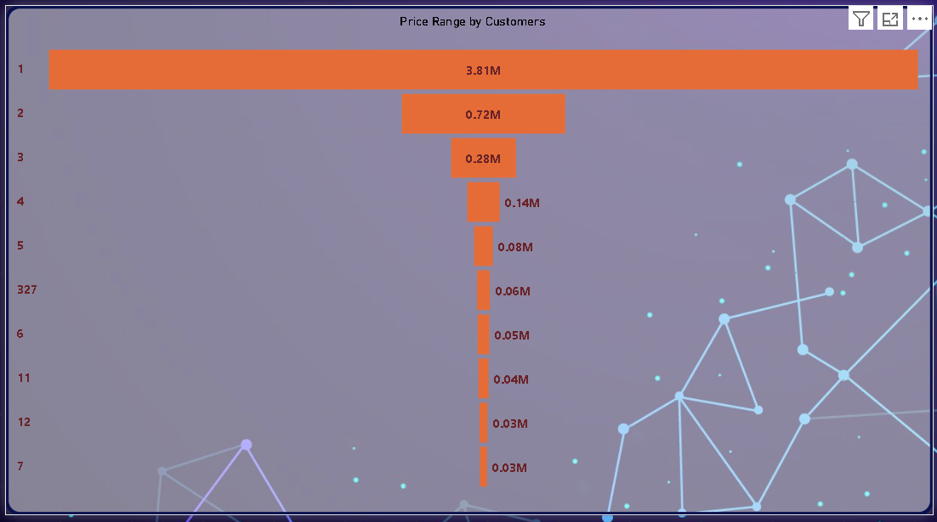
Preferred pricing ranges analysis
Understanding customer price sensitivity and preferred booking ranges is key to competitive pricing strategies. Analysis indicates individuals prefer to have single room which eventually generated maximum revenue. Aligning property offerings with these preferences helps maximum rates and revenue.

Slide 10
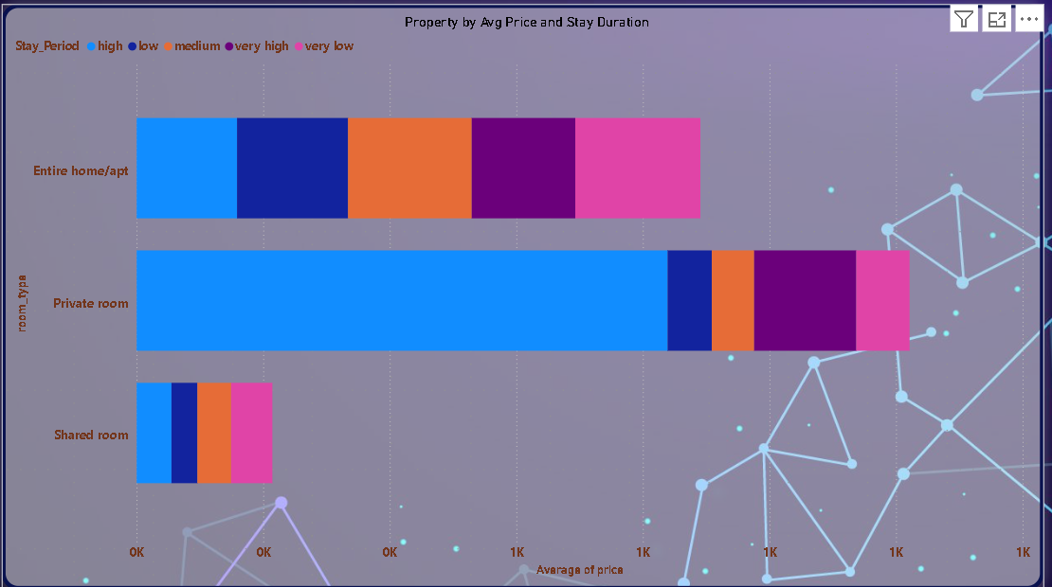
Property types favored by different customer segments
Different customer groups prefer majorly entire house where a individuals prfers to have single rooms. Segmenting customers by their property preferences allows Airbnb to tailor inventory acquisition and marketing to match demand, enhancing guest experience and loyalty.

Slide 11
03
Property Enhancement and Popularity

Slide 12
Features to improve existing properties
Enhancing properties by adding amenities like reliable Wi-Fi, flexible check-in, and enhanced cleanliness standards aligns with customer expectations. These improvements can increase booking rates and positive reviews, boosting a propertys attractiveness.

Slide 13
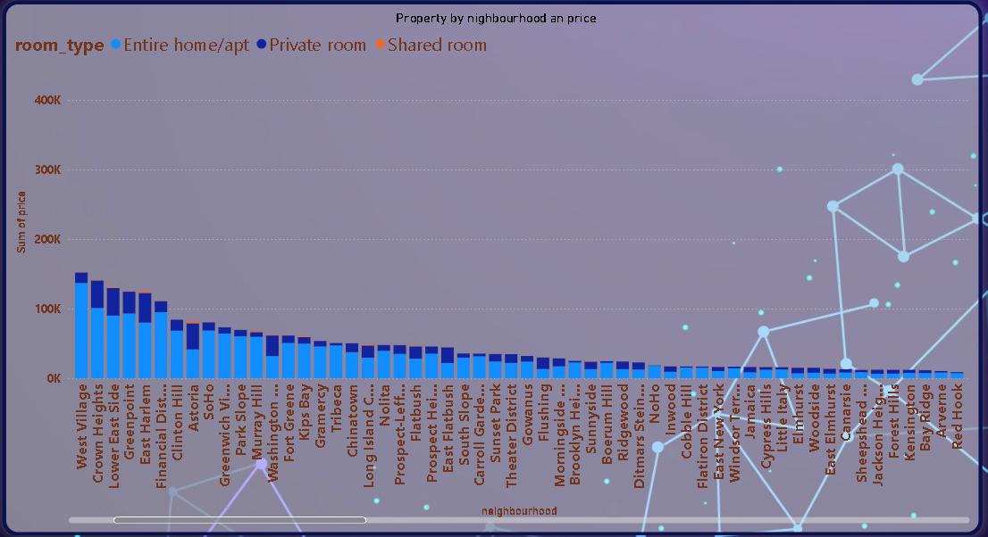
Analysis of popular neighborhoods and property types in New York
Current data shows neighborhoods like Williamburg and Bedford-Stuyvesantlead in popularity, with private room and entire house in demand. Understanding these preferences helps prioritize investments and marketing efforts to capture customer interest and optimize revenue.

Slide 14

Strategies to increase traction for less popular properties
Boosting visibility through targeted promotions, dynamic pricing, and leveraging guest reviews can attract bookings. Enhancing property presentation with professional photos and offering unique experiences help convert less popular listings into sought-after options.

Slide 15

Conclusions
Leveraging data-driven insights on hosts, customer segments, and property features positions Airbnb to effectively capitalize on increased travel demand. Focused strategies on acquisition, pricing, and property improvements will drive revenue growth and strengthen Airbnb’s competitive edge in key markets.

Slide 16
THANK YOU
2XXX
Please keep this slide for attribution

